Slide 1
Bayesian Model Calibration
Advanced DARTH Workshop
April 2024

Slide 2
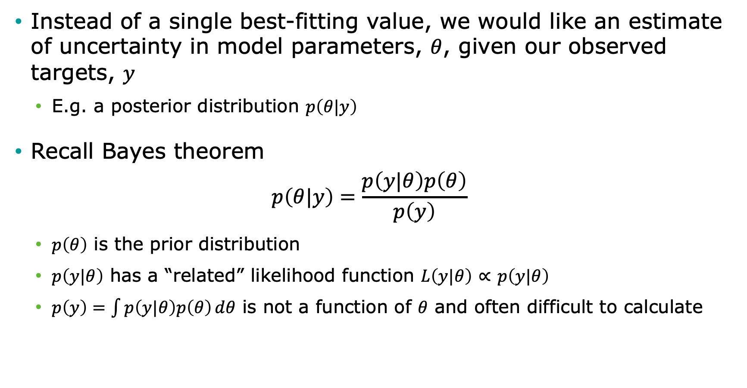
Bayesian setup
Instead of a single best-fitting value, we would like an estimate of uncertainty in model parameters, $θ$, given our observed targets, $y$
E.g. a posterior distribution $p\left(θ|y\right)$
Recall Bayes theorem
$$p\left(θ|y\right)=\frac{p\left(y|θ\right)p\left(θ\right)}{p\left(y\right)}$$
$p\left(θ\right)$ is the prior distribution
$p\left(y|θ\right)$ has a “related” likelihood function $L\left(y|θ\right)$ $∝$ $p\left(y|θ\right)$
$p\left(y\right)=\int{p\left(y|θ\right)p\left(θ\right)}dθ$ is not a function of $θ$ and often difficult to calculate

Slide 3
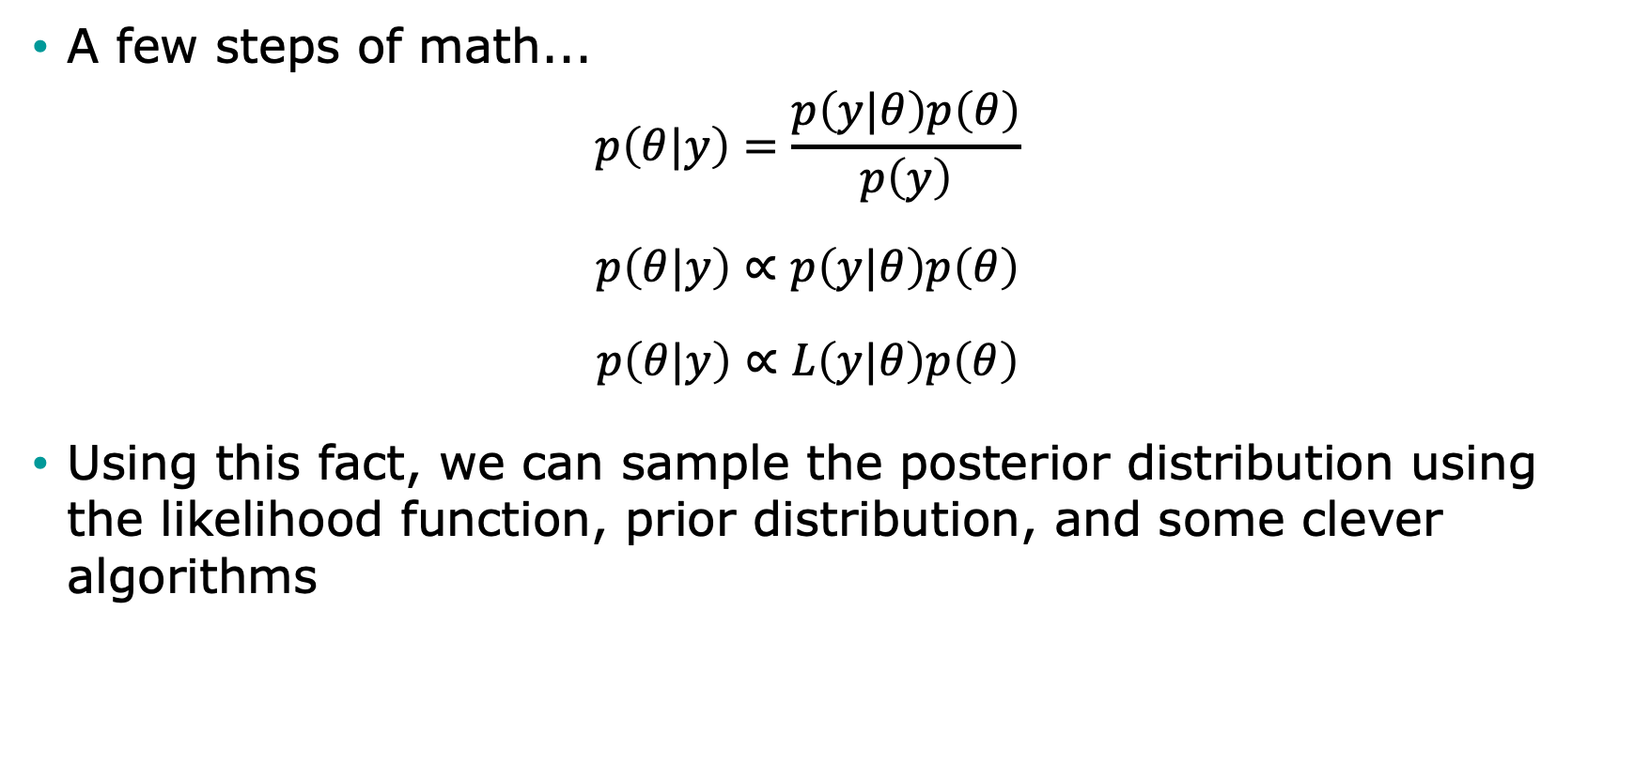
Bayesian setup
A few steps of math...
$$p\left(θ|y\right)=\frac{p\left(y|θ\right)p\left(θ\right)}{p\left(y\right)}$$
$$p\left(θ|y\right)∝p\left(y|θ\right)p\left(θ\right)$$
$$p\left(θ|y\right)∝L\left(y|θ\right)p\left(θ\right)$$
Using this fact, we can sample the posterior distribution using the likelihood function, prior distribution, and some clever algorithms

Slide 4
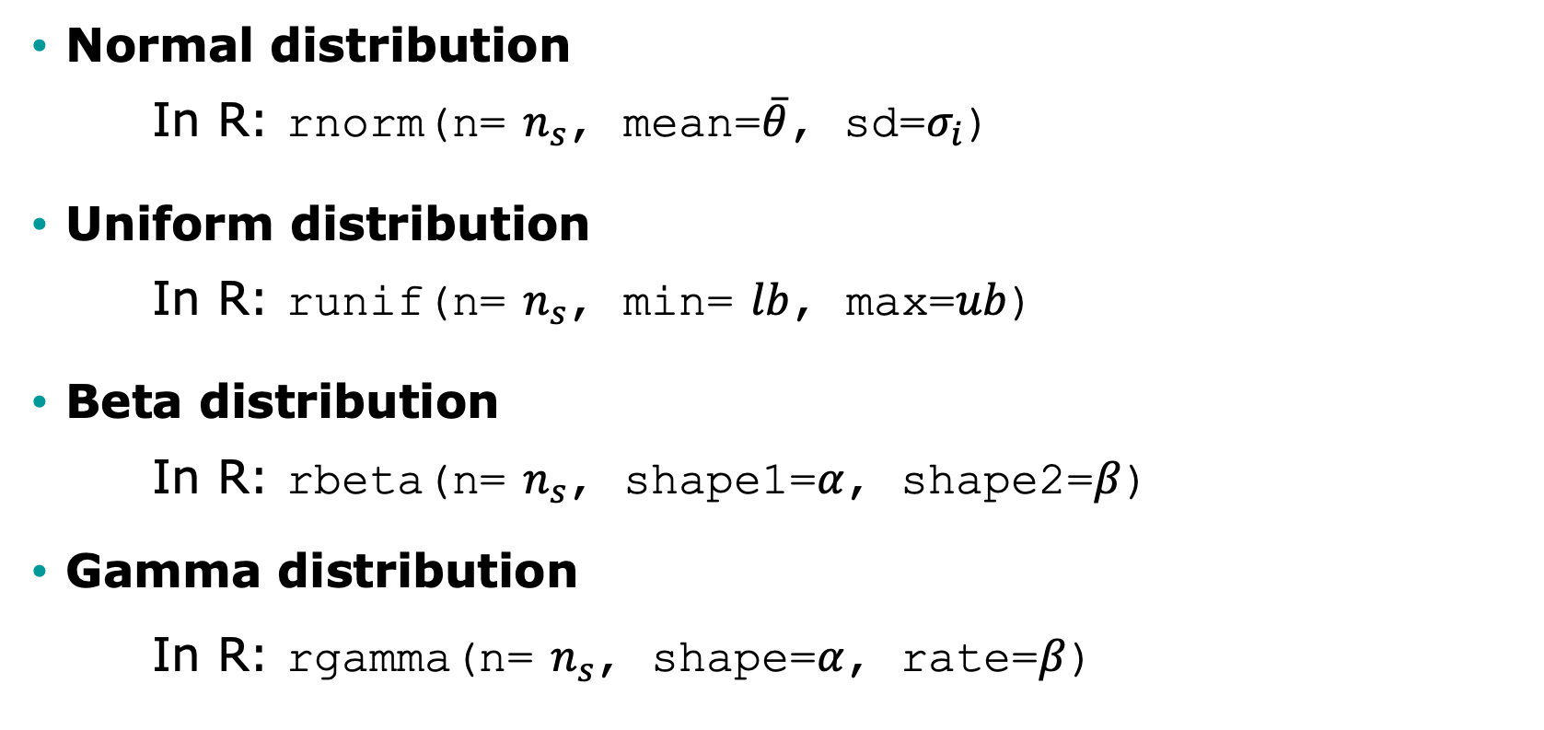

Commonly used prior distributions for sampling $n_{s}$ values
Normal distribution
In R: rnorm(n= $n_{s}$, mean=$\overline{θ}$, sd=$σ_{i}$)
Uniform distribution
In R: runif(n= $n_{s}$, min= $lb$, max=$ub$)
Beta distribution
In R: rbeta(n= $n_{s}$, shape1=$α$, shape2=$β$)
Gamma distribution
In R: rgamma(n= $n_{s}$, shape=$α$, rate=$β$)

Slide 5
Pros and Cons of Bayesian Calibration
Pros: We obtain distributions of parameters rather than only point estimates
Cons: “Harder” to implement than other methods? Mmm not really!

Slide 6
Obtaining a Posterior Distribution
Analytically
Not feasible for simulation models
Markov chain Monte Carlo (MCMC)
Sampling methods
Sampling Importance Resampling (SIR)
Incremental Mixture Importance Sampling (IMIS)

Slide 7
Markov chain Monte Carlo (MCMC)
Simulates posterior distribution by jumping in the parameter space in a Markovian fashion
The transition matrix of the Markov chain is proposed using a proposal distribution
There are numerous MCMC algorithms, including Metropolis-Hastings (MH)
R has some packages that implement MCMC algorithms
Other R packages interface with external MCMC software, including WinBUGS, JAGS, and Stan

Slide 8
Markov chain Monte Carlo (MCMC)
Pros:
Theoretically will eventually converge to the “true” posterior distribution
Cons:
Computationally intensive
Autocorrelation is a problem with simulation models and therefore requires a high number of samples
Use of external software (WinBUGS, JAGS), requires implementing the model within that software’s syntax

Slide 9
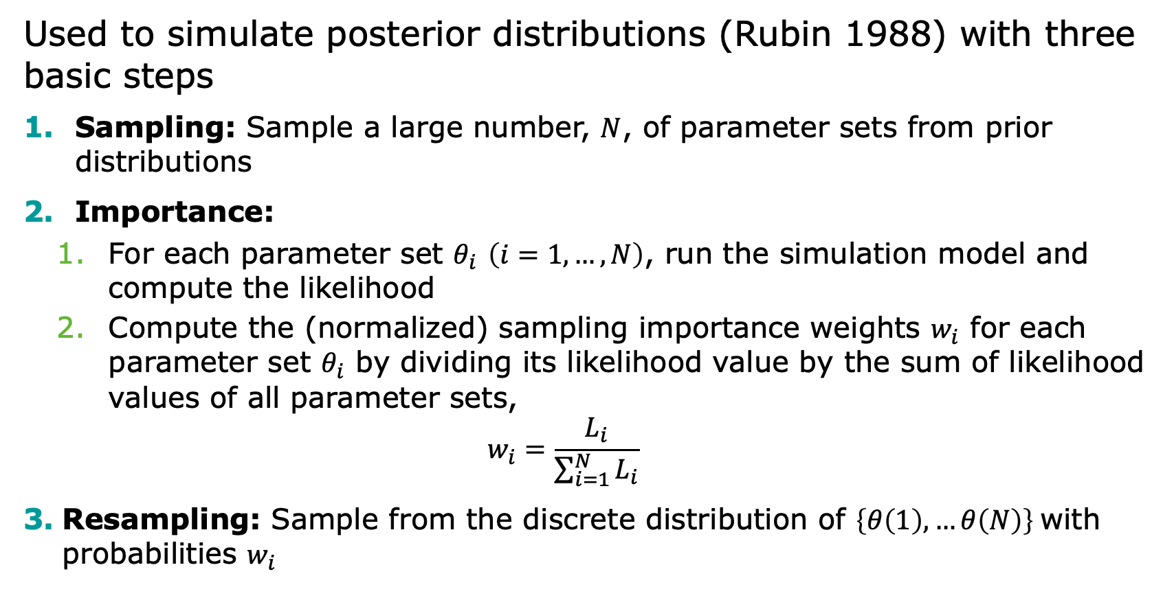
Sampling Importance Resampling (SIR)
Used to simulate posterior distributions (Rubin 1988) with three basic steps
Sampling: Sample a large number, $N$, of parameter sets from prior distributions
Importance:
For each parameter set $θ_{i}$ $\left(i=1,…,N\right)$, run the simulation model and compute the likelihood
Compute the (normalized) sampling importance weights $w_{i}$ for each parameter set $θ_{i}$ by dividing its likelihood value by the sum of likelihood values of all parameter sets,
$$w_{i}=\frac{L_{i}}{\sum_{i=1}^{N}{L_{i}}}$$
Resampling: Sample from the discrete distribution of $\left\{θ\left(1\right), …θ\left(N\right)\right\}$with probabilities $w_{i}$

Slide 10
Incremental Mixture Importance Sampling (IMIS)
SIR can miss areas of high posterior probability as the number of parameter increases
IMIS addresses limitations of SIR and was proposed by Steele at al. (2006)
Starts with a modest-size SIR
But in addition to SIR samples, add in samples from a multivariate normal distribution centered at the point with the highest importance weight
Recalculate importance weights and sample a new sample of input parameter sets
At the end, posterior becomes a mixture of multivariate normal distributions and of the prior distribution

Slide 11
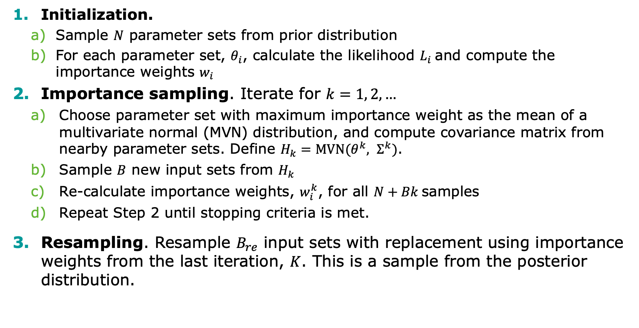
Incremental Mixture Importance Sampling (IMIS)
Initialization.
Sample $N$ parameter sets from prior distribution
For each parameter set, $θ_{i}$, calculate the likelihood $L_{i}$and compute the importance weights $w_{i}$
Importance sampling. Iterate for $k=1, 2, …$
Choose parameter set with maximum importance weight as the mean of a multivariate normal (MVN) distribution, and compute covariance matrix from nearby parameter sets. Define $H_{k}=\text{MVN}(θ^{k}, Σ^{k})$.
Sample $B$ new input sets from $H_{k}$
Re-calculate importance weights, $w_{i}^{k}$, for all $N+Bk$samples
Repeat Step 2 until stopping criteria is met.
Resampling. Resample $B_{re}$ input sets with replacement using importance weights from the last iteration, $K$. This is a sample from the posterior distribution.

Slide 12
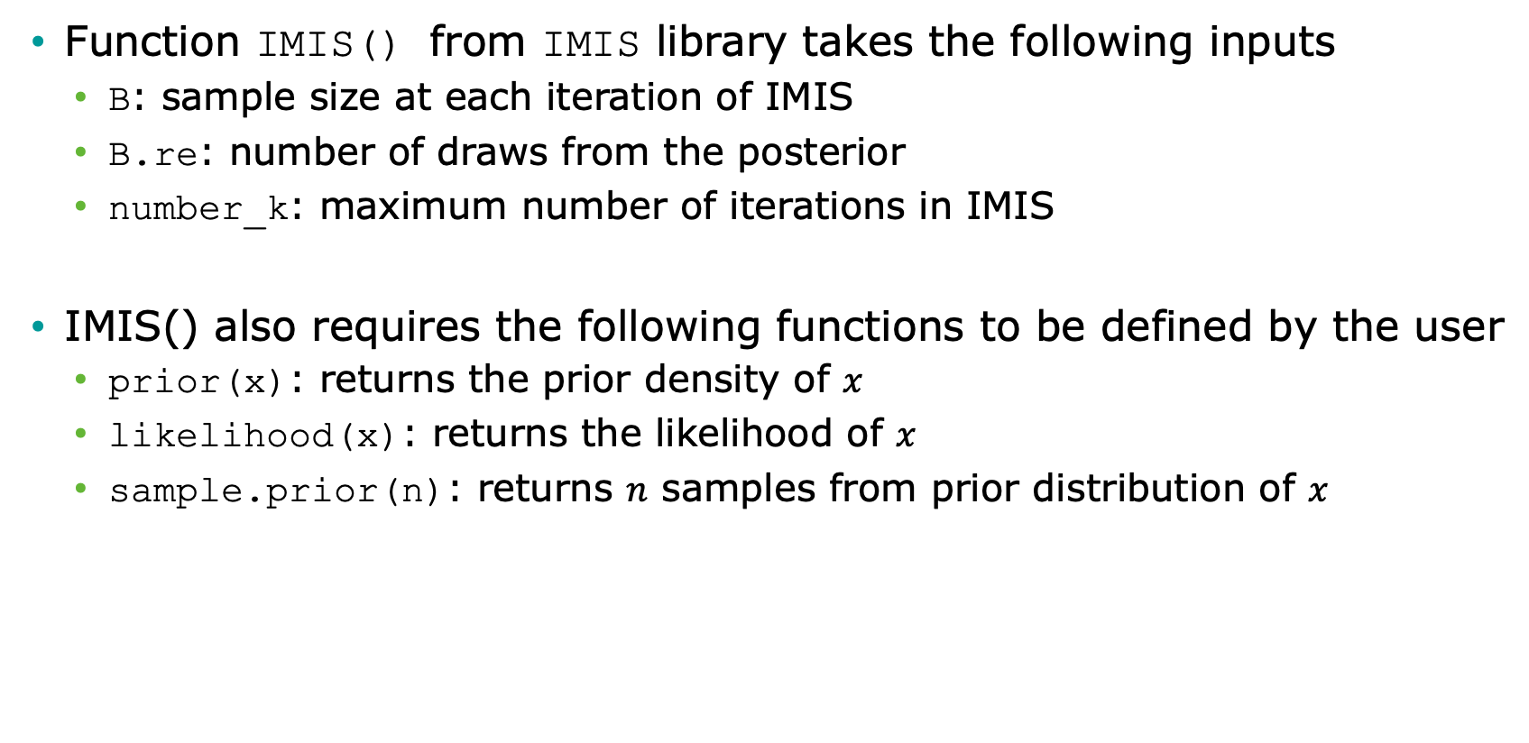
Incremental Mixture Importance Sampling (IMIS) in R
Function IMIS() from IMIS library takes the following inputs
B: sample size at each iteration of IMIS
B.re: number of draws from the posterior
number_k: maximum number of iterations in IMIS
IMIS() also requires the following functions to be defined by the user
prior(x): returns the prior density of $x$
likelihood(x): returns the likelihood of $x$
sample.prior(n): returns $n$ samples from prior distribution of $x$

Slide 13
Incremental Mixture Importance Sampling (IMIS) Outputs
resamples: B.re draws from the posterior distribution
stat: diagnostic statistics at each IMIS iteration
MargLike:
UniquePoint: expected number of unique points among resamples
MaxWeight: maximum importance weight
ESS: effective sample size (the closer to B.re, the better)
center: center of Gaussian components

Slide 14
R Session
Notes:
Part 1 = Showing code 3 state model
Part 2 = Exercise build Sick-Sicker model
Part 3 = Show answers of Sick-Sicker

